Slide 1
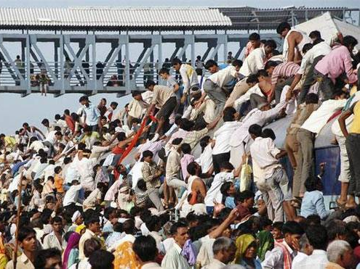
BES166=> HRD: Today’s Topics
Census
Edu. Policy 2016
Health-Women, Children
HDI-2015 | SDG

Slide 2
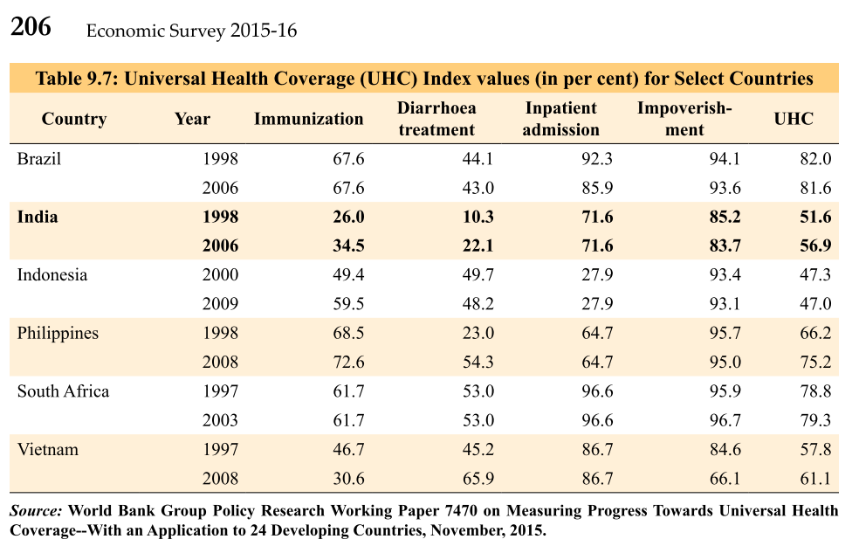
Universal Health Coverage index (UHC) by World Bank
India’s rank- among the bottom countries

Slide 3
Healthcare
Prime Minister’s Jan Aushadhi Yojana
3000 new stores for generic drug supply
Health insurance
Rs.One lakh per family.
Addl. 30k for senior citizen > 60 years
National Dialysis Services Programme
Each session cost Rs.2k
PPP centers to reduce cost
Duties/taxes reduce.
Budget-2016

Slide 4

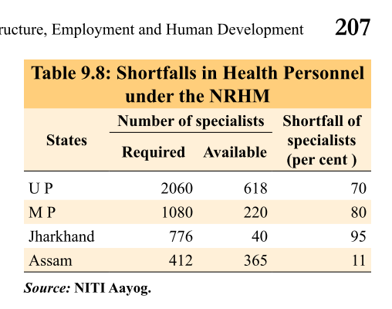
health schemes are “Core Schemes”- 60-40| 90-10
National Health Mission (NHM)
Rural (NRHM)
Urban Health Mission (NUHM)
Pop >30k (Survey)
50k/> (Yb)
ASHA workers...yes (since 2013)
Notes:
Accredited Social Health Activists (ASHAs)

Slide 5
health schemes are “Core Schemes”- 60-40| 90-10
Jt. Program for Non-Communicable Diseases (NCDs)- heart, diabetes, cancer
Health Min
AYUSH Min.
Notes:
Accredited Social Health Activists (ASHAs)

Slide 6
Health Misc.
Rogi Kalyan Samiti:
registered society whose members act as trustees to manage the affairs of the hospital
National Ambulance Services
108: accident, trauma, emergency
102: pregnant women in JSSK

Slide 7
MMRate: within 42 days of delivery/1lakh live birth
MDG
MMR: 140 / 1 lakh live birth
Under 5 mortality rate (U5MR): 42
India
141 (2015);
178 (Census);
190 (HDR-2015)
52(P), 42 (2015)

Slide 8
Formula: Child Mortaility
IMR: Infant mortality Rate
CMR: Child Mortality Rate
Before 1st B’day/ Per 1000 live birth
Rural (46); Urban (28); Total (42)
BEST Kerala | Worst: MP, ASM, ODS,UP
(0-4) year kids / 1000 children
India: 11
Neo-Natal: <29 days
Notes:
Birth: 21.6 / 1000
KRL <……<BIHAR
Death: 7 / 1000
MH, WB<…..<ODS

Slide 9
Pregnant women: Health Ministry
Janani Suraksha Yojana'05
encourage institutional delivery
To reduce MMR
Janani Shishu Suraksha Karyakram (JSSK)'11, Jan
free delivery @Government hospital
free Caesarean delivery
+ child upto 1 year. +drug, diet, transport (102 ambulance)
PM Suraksheet Matritwa Yojana'2016
ante-natal checkup for pregnant women on ninth of every month by a specialist.
use private doctors if sarkaari not available
Notes:
Janani Suraksha Yojana'05
Health Min.
encourage institutional delivery
To, reduce MMR (174 / 1 lakh live births)
Janani Shishu Suraksha Karyakram (JSSK)'11, Jan
Health Min.
free delivery @Government hospital
free Caesarean delivery
+ child upto 1 year.
+drug, diet, transport (102 ambulance)
PM Surakshit Matritwa Yojana'2016
Health Min.
ante-natal checkup for pregnant women on ninth of every month by a specialist.
use private doctors if sarkaari not available

Slide 10
Pregnant women: MWCD?
IG Matritva Sahyog Yojana’10
Crèche
conditional cash transfer for wage loss
Rajiv Gandhi National Creche Scheme for the Children of Working Mothers
100% CSS

Slide 11

Indradhanush
Vaccination
Time: 2014 to 2020
Full and free Vaccination- children and Preg. Women (Tetanus)
Seven diseases diphtheria, whooping cough, tetanus, polio, tuberculosis, measles, and Hep.B.
Selected states: Jap.encp., Influenza type-B

Slide 12
Infants and children
Rashtriya Bal Swasthya Karyakram: 2013
disease detection, disability
India Newborn Action Plan (INAP): 2014, Sept.
Reduce preventable newborn deaths and stillbirths
Single digit Neonatal MR by 2030
Reproductive, Maternal, Newborn, Child and Adolescent health (RMNCH+A)
Rashtriya Kishor Swasthya Karyakram: 2014, Jan
25 cr. adolescent
life skill, sexual health, addiction

Slide 13
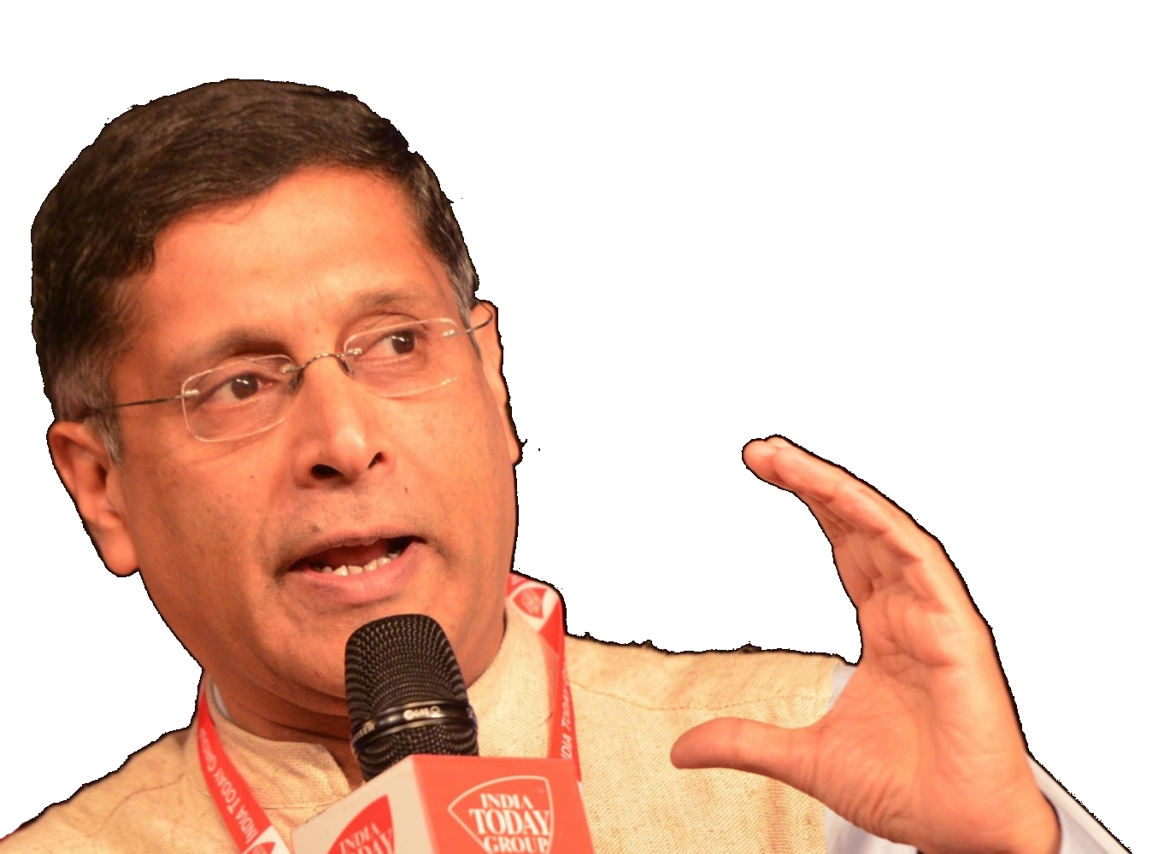
V1c5: Early life intervention
Thin mother = weak babies
Indian women don’t get sufficient weight gain in preg.
Early life intervention
food/iodine/iron supplement for mother+child<5 yr = cheaper < investing in teachers to give separate classes to 5th std. kids weak in Maths and English.
Open defecation is bad because
Low-wt babies die neo-natal (first 30 days)
Taller/fatter kids are better readers.
environmental enteropathy: repeated germ exposure via open defecation = a chronic inflammation in intestine = can't absorb nutrition fully.
Diarrhea= not enough time for food to get absorbed in GI track= malnutrition.
No open defecation = taller children in given age.

Slide 14
Sex ratio
All India: 943/1000
Kerala 1084, TN, AP | Pudu (1037)
Haryana: 879 | D&D (618)
All India
(0-6) age / 1000 kids
All India 914 | Constant negative since ’71
Child sex ratio
=(total female/total male) x 1000
Highest: Arunanchal (972)| A&N (968)
Lowest: Haryana (832)| Delhi (871)

Slide 15
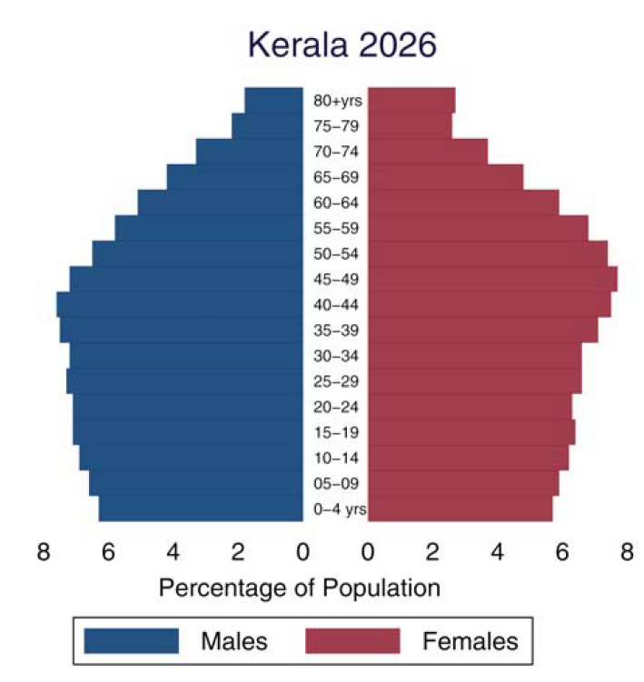
NCERT Class 12 soc.ch2.
If there was no sex selective abortion or gender specific-violence then
Sex ratio would be in favor of females
Sex ratio would be in favor of males
Sex ratio would be “1”
can’t be predicted.
In favour of females because
Girl child = more resistant to disease
Older women live longer than men- diseases, violence

Slide 16
NCERT Class 12 soc.ch2.
Regarding sex-ratio in India
Sex ratio is lowest in most of the prosperous regions of India
Maternal mortality is highest in most of the backward regions of India
Sex ratio is high in the source areas of migration.
All of above.
Migration
sonography
Notes:
The availability of the sonogram
(an x-ray like diagnostic device based on ultra-sound technology), or

Slide 17
Women: major schemes
Beti Bachao, Beti Padhao
improving sex ratio; education; target 100 most bogus districts + Sukanya Samridhi this article
SABLA
Rajiv Gandhi Scheme for Empowerment of Adolescent Girls- Age 11-18
Priyadarshini
Mid Gangetic Plains of UP+Bihar
Empowerment and Livelihood Programme in the
Mahila Samakhya ’89 [HRD]
Rural women education – meet ask qs.
STEP
Support to training and employment program
Working women hostel=>MWCD
Nutrition, non-nutrition
For boys=> Saksham
Sneh Shibir
Malnutrition among women.

Slide 18
Women: major schemes
Swadhar Scheme ('01)
women in difficult circumstances and without any family, social and economic support
widows, disaster, jail-release etc. 300+ homes, 8k beneficiaries
Ujjawala ('09)
trafficked women (MWCD)
Ujjawal”A”
LPG in name of BPL woman (Petrol Min)
Rashtriya Mahila Kosh (RMK)
WMCD=> Micro-finance to NGO=> SHG. Not direct lending.
Poorna Shakti Kendra
Coordination => women can seek help of various programs/schemes.

Slide 19
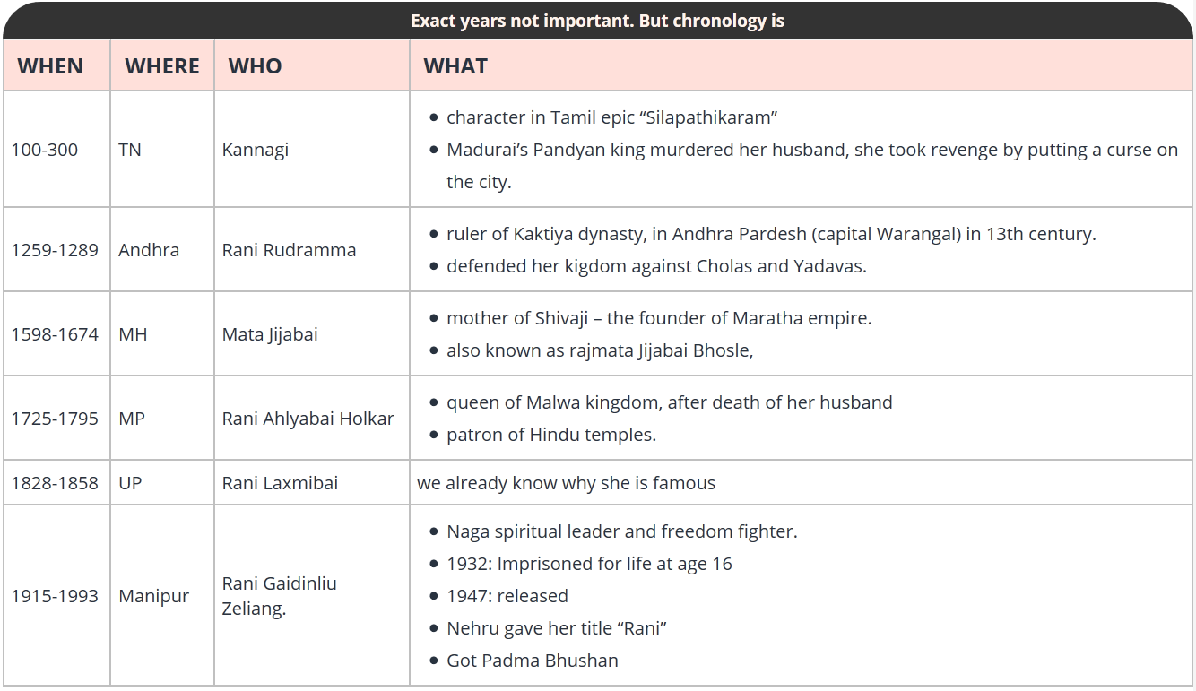
MWCD: Stree Shakti Puraskar: 6 x 3 lakhs
Notes:
‘
of social development, the government has instituted six national awards known as ‘Stree Shakti Puraskar’. These awards carrying a cash prize of ₹ 3 lakh
Devi Ahilya Bai Holkar, Kannagi, Mata Jijabai, Rani Gaidenliou Zeliang, Rani Lakshmi Bai and Rani Rudramma Devi.

Slide 20
Statutory body for women and children
GS2: Bodies
1990 made in ‘91
National Commission for Women (NCW)
2006 made in ‘07
National Commission for Protection of Child Rights (0-18)
2016: new policy for women
Krishi Sakhi: last mile extension workers
1098: Child helpline
Roughly based on Pam Rajput Committee

Slide 21

Women safety through phones
I&B min
By 2018- all phones must have
In-built GPS
Panic button- either in “5” or “9” key.
Nirbhayaa fund to be used for running hotline

Slide 22

Disabled & research

Slide 23
Disabled (Divyang- Rail budget)
Function?
11th Schedule to Article 243-G
12th Schedule to Article 243-W
Law?
40%/> disability | Mental also counted
’95: PwD Act=> Chief commissioner
Yearbook/Scheme
Accessible India: Sugamya Bharat
ALIMCO: Artificial Limbs Manufacturing Corporation of India, Kanpur (Min. of Social justice)
Notes:
Chief commissioner of language?
Persons with Disabilities (Equal Opportunities, Protection of Rights and Full Participation) Act, 1995, (also referred to as PwD Act, 1995) defines “Person with Disability” as a person suffering from not less than 40 per cent of any disability as certified by a medical authority.
(f) mental illness (g) mental retardation (h) autism (i) cerebral palsy
Chief Commissioner is an important statutory functionary, appointed under Section 57 of The Persons with Disabilities
The is a public sector body, engaged in manufacturing of aids and appliances
of Social Defence the Ministry is committed towards welfare of Older Persons and rehabilitation of Drug Addicts

Slide 24

ICMR associated with
yearbook
Crimean Congo Hemorrhagic Fever (CCHF)- found in Gujarat and Rajasthan; "Hyalomma" ticks => Animals => Human
Magnivisualizer for cervical cancer
HIV vaccines: Macaca mulatta (Rhesus monkeys) prior to conducting human trials.
Vaccine for Japanese Encephalitis
Uricase Enzyme- diagnotic kit to measure uric acid level
Notes:
Ferritin estimations technology.
diagnosis procedure for visceral leishmaniasis from urine
Poliomyelitis

Slide 25
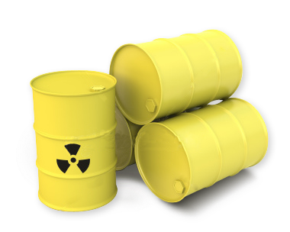
BARC working on
yearbook
Iodine-125: Eye cancer
Radiation-hydrogel to treat burns, wounds and leprosy;
Radioimmunoassays (RIA) to measurements of hormones, enzymes, protein
radiopharmaceuticals: arthritis, TB detection

Slide 26
Food Irradiation
yearbook
BARC at Lasalgaon near Nashik: radiation for food-preservation: onion, pulses, rawa and turmeric.
X-ray, Gamma-Ray => microorganisms, insects killed + Potato, onions: no sprout.

Slide 27


AYUSH
yearbook
Latest: Sowa Rigpa (Tibetian)
Ayurveda, Siddha, Unani and Homoeopathy drugs fall under of Drugs and Cosmetics Act, 1940.
National Medicinal Plants Board: Under health ministry
2014, Sep: UN GA declared June 21st as international yoga day.
2014, Nov- made full fledged ministry
National AYUSH Mission (NAM)= cost effective medicine + education reform

Slide 28
BES166=> HRD: Today’s Topics
Census
Edu. Policy 2016
Health-Women, Children, Disabled,RD
HDI-2015 | SDG

